Slide 1

AR-MULTI++ Web: Context-Aware Multilingual Scene Text Recognition, Translation, and Voice Output with Augmented Reality Simulation
Seshadri Rao Gudlavalleru Engineering College, Gudlavalleru
Department of Computer Science and Engineering
By
M.Navya 22481A05E1
P.Varshitha 22481A05J4
N.Karthik 22418A05G9
M.Raj Vardhan 22481A05E7
Under the guidance of
Mr.P.S.GANESH KUMAR
Assistant Professor, Department of CSE

Slide 2
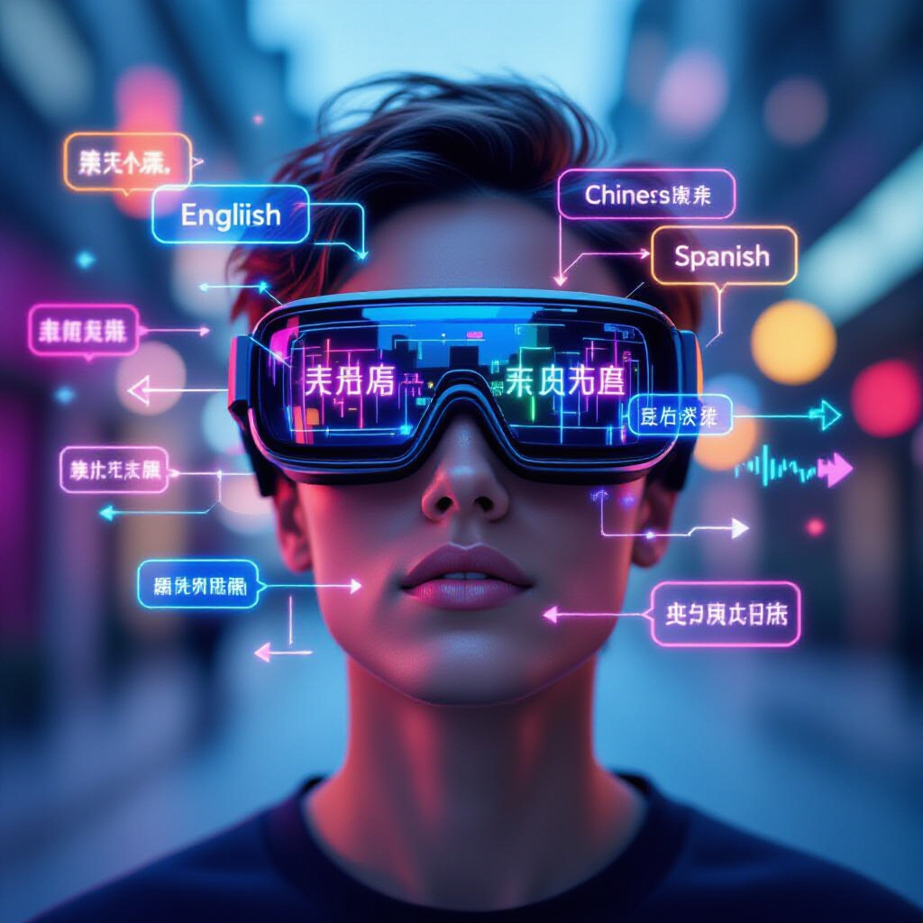
AR-MULTI++ Web : Context-Aware Multilingual Scene Text Recognition, Translation, and Voice Output with Augmented Reality Simulation

Slide 3
Abstract
AR-MULTI++ enables seamless multilingual communication by combining Scene Text Recognition (STR), context-aware translation, and speech synthesis. It processes text from images in multiple languages, including mixed forms like Hinglish and Tenglish, with image enhancement for low-quality inputs. Unlike traditional pipelines, it uses scene-context analysis for higher accuracy. Translations appear as AR overlays and are voiced in the user’s preferred language, making it practical for travelers, educators, and accessibility needs.

Slide 4
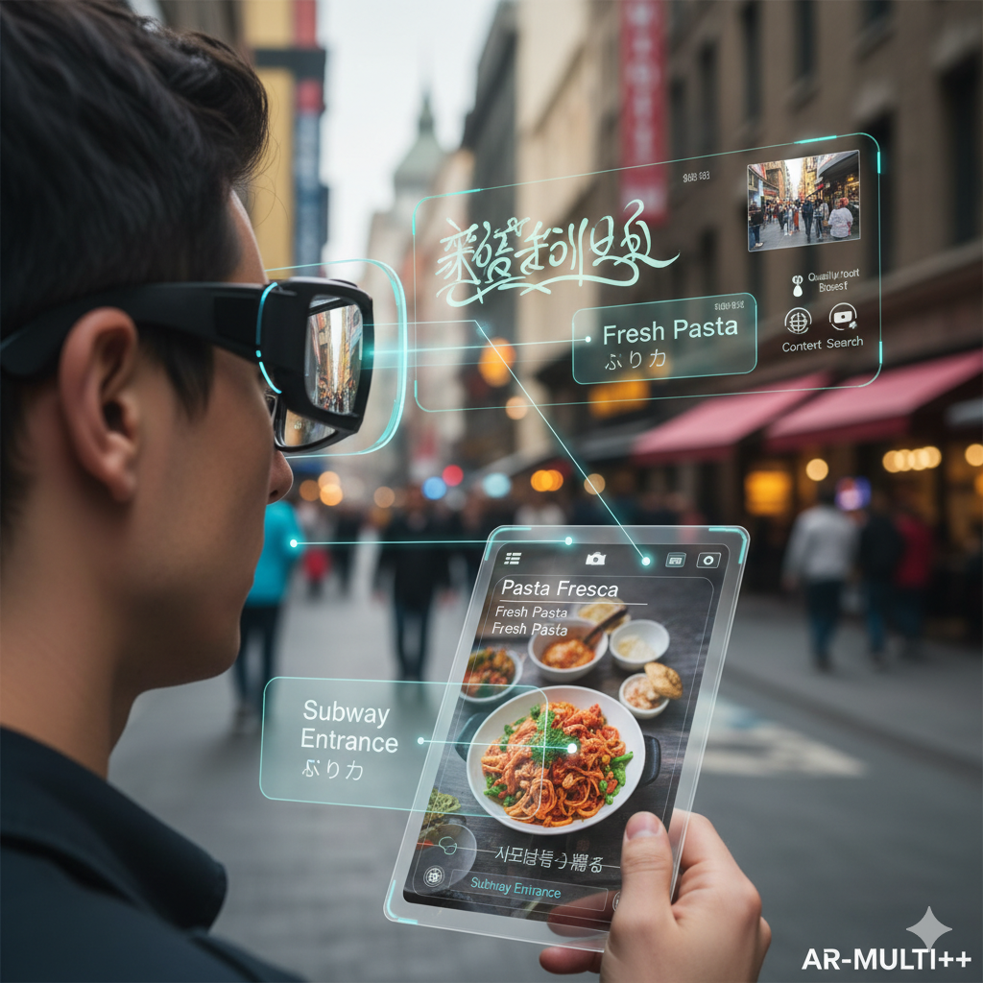
Introduction
The proliferation of visual information in daily life necessitates efficient ways to process and understand it.
Text present in images, signs, menus, and documents often requires translation or reading assistance.
Challenges include handling multiple languages, poor image quality, and the need for real-time, context-aware processing.
AR-MULTI++ aims to bridge these gaps by providing an accessible, intelligent, and versatile solution.

Slide 5
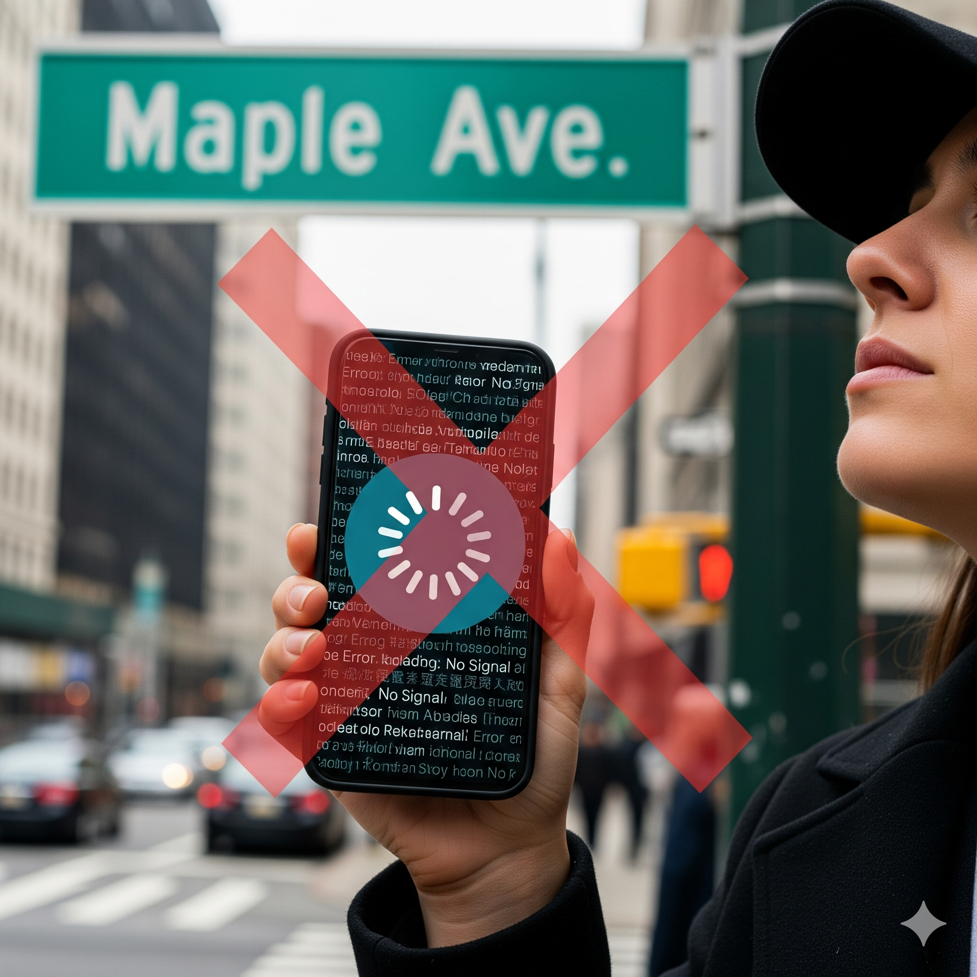
Existing System
Google Translate (Camera / Lens) – Supports real-time camera-based translation with text-to-speech output. Limitations: Requires internet connectivity and shows reduced accuracy for mixed-language and context-dependent text.
Microsoft Translator – Provides camera-based translation with voice output. Limitations: Lacks AR overlay support, with weaker mixed-language and contextual interpretation.
Apple Translate with Live Text – Enables image-based text detection and translation. Limitations: Restricted to iOS devices, with limited Indian language coverage and no contextual translation.
Open-Source OCR Tools (Tesseract, ML Kit, PaddleOCR) – Offer multilingual text recognition via APIs. Limitations: Require manual integration and lack AR visualization, contextual translation, and mixed-language handling.

Slide 6
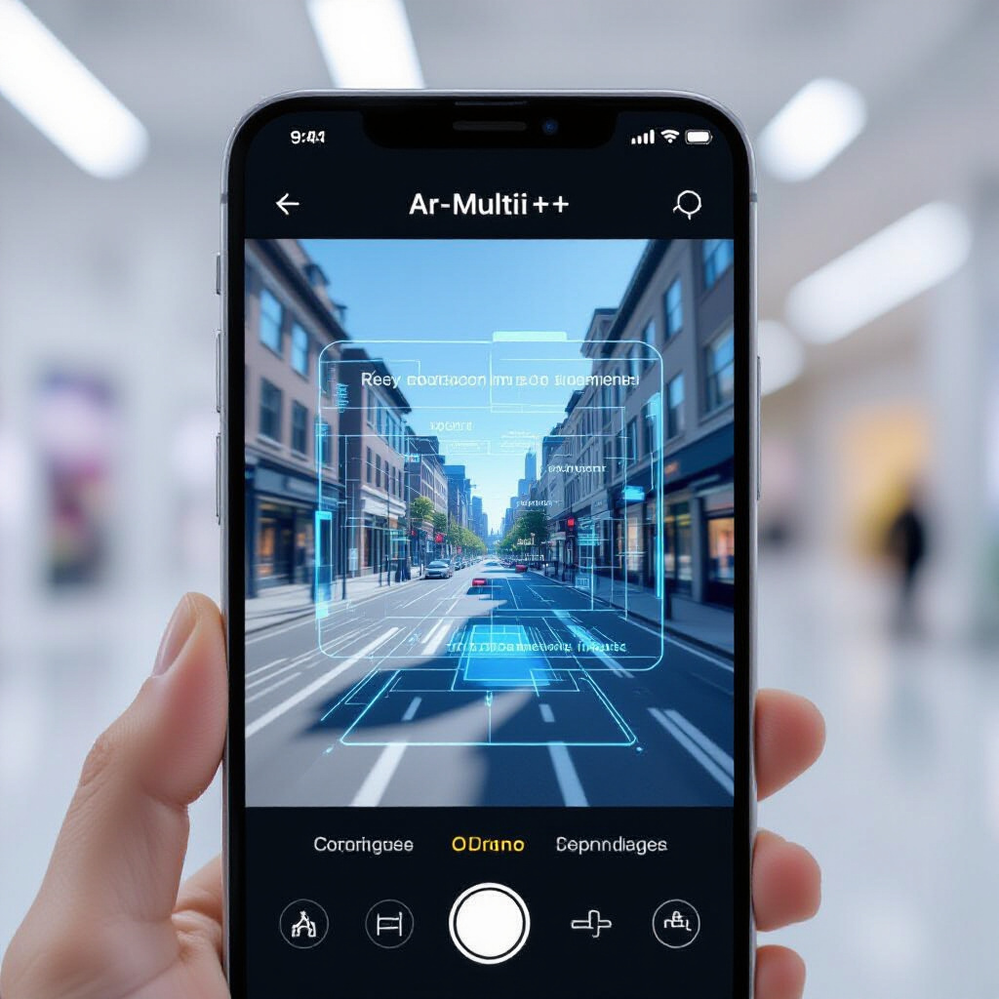
Proposed System: AR-MULTI++
A unified application for text recognition, translation, and text-to-speech.
Advanced OCR capable of recognizing text in various languages, including mixed scripts.
Context-aware translation engine to improve accuracy.
Integrated Text-to-Speech (TTS) for audible output of translated text.
Simulated Augmented Reality overlay on standard display screens.
Robust image pre-processing for enhanced recognition in challenging conditions.

Slide 7
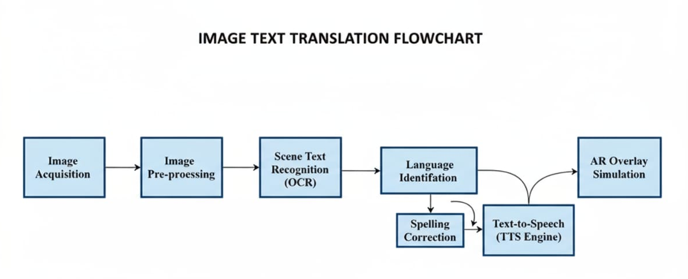
System Flowchart Diagram
Diagram illustrating the data flow from image input through recognition, translation, voice synthesis, and AR display.

Slide 8
Explanation of Components
Image Acquisition: Capturing images or using existing ones from the device gallery.
Image Pre-processing: Enhancing image quality (denoising, contrast adjustment, deskewing).
Scene Text Recognition (OCR): Detecting and recognizing text regions in the image.
Language Identification: Determining the language(s) of the recognized text.
Contextual Translation: Translating text, leveraging scene context and object recognition if available.
Text-to-Speech (TTS) Engine: Converting translated text into spoken audio.
AR Overlay Simulation: Displaying translated text overlaid on the original image/video feed on a standard screen.
Spelling Correction: Using language models to fix minor OCR or translation errors.

Slide 9
Project Objectives
Perform multilingual OCR on scene text images.
Provide real-time translation into multiple languages.
Generate clear text-to-speech audio.
Produce AR-style translated text overlays.
Deliver a fast, accurate, and responsive user experience.

Slide 10
Related Work
OCR: Evolved from classical methods to deep learning, enabling accurate multilingual scene-text recognition.
NMT: Modern systems provide fast, context-aware translation and handle mixed-language inputs effectively.
TTS: Advanced models generate natural, clear multilingual speech with improved pronunciation.
AR Text Visualization: AR enables placing translated text onto real-world images for better readability.
Multimodal Systems: Recent research integrates OCR, translation, TTS, and AR to create unified, intelligent text-processing applications.

Slide 11
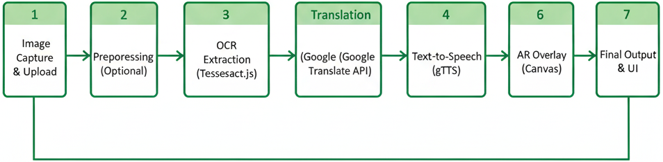
Methodology
1. Image Capture & Upload
User uploads or captures an image.
Frontend sends image + target language to backend.
2. Preprocessing (Optional)
Basic enhancements like resize and contrast adjustments to improve OCR.

Slide 12
3. OCR Extraction (Tesseract.js)
Extracts text, detects word positions, and provides confidence scores.
4. Translation (Google Translate API)
Converts extracted text into the selected target language.
5. Text-to-Speech (gTTS)
Generates MP3 audio of the translated text for playback.
6. AR Overlay (Canvas)
Draws original image and overlays translated text using OCR bounding boxes.
7. Final Output & UI
Frontend displays extracted text, translation, overlay image, and audio with download options.

Slide 13
Dataset Material
ICDAR Scene Text: Real-world images with multilingual text for OCR testing.
MLT Dataset: Multi-language scene text dataset for script and language recognition.
COCO-Text: Large collection of natural images with visible text.
SynthText: Synthetic images used to increase OCR training/testing variety.
OPUS / OpenSubtitles: Multilingual text pairs useful for translation evaluation.

Slide 14
Links to datasets:
SynthText: (Search 'SynthText dataset' or refer to relevant research papers)
ICDAR Datasets: https://rrc.cvc.uab.es/?com=d&a=view&e=2
COCO-Text: https://cocodataset.org/#captions (Refer to COCO-Text paper for specific access)
WMT Datasets: http://www.statmt.org/wmt21/translation-task.html (Links vary by year)
Opus Corpus: https://opus.nlpl.eu/
LJSpeech: https://keithito.com/LJ-Speech-Dataset/

Slide 15
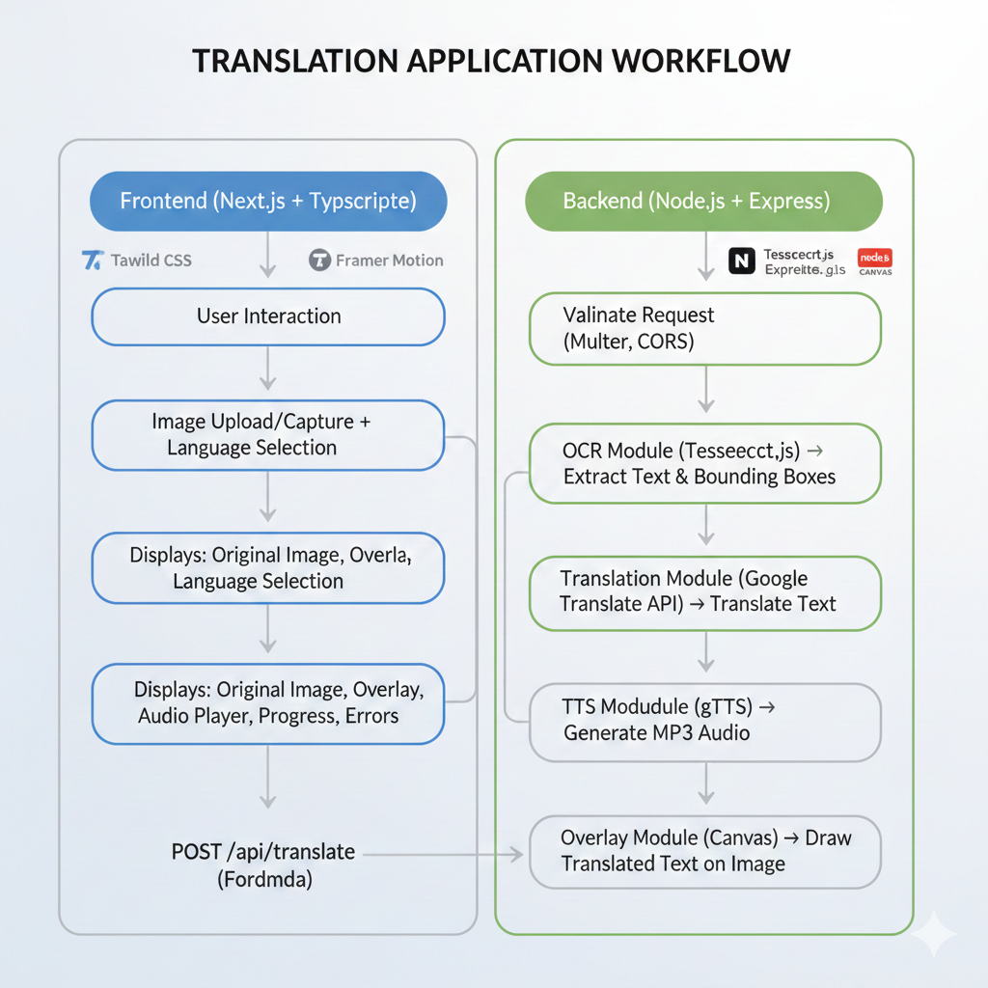
Implementation

Slide 16
Frontend (Next.js + TypeScript)
Handles image upload/capture, language selection, and output preview.
Shows original image, overlay, audio, progress, and errors.
Built with Tailwind CSS + Framer Motion for responsive and smooth UI.
Sends FormData to backend via POST /api/translate.
Backend (Node.js + Express)
Uses multer for image upload and CORS/env configuration.
OCR: Extracts text + bounding boxes using Tesseract.js.
Translation: Converts text via Google Translate API.
TTS: Generates MP3 audio using gTTS.
Overlay: Draws translated text on image using Canvas.
Controller Workflow
Validate request → OCR → Translation → TTS → Overlay → Return JSON + base64 outputs.

Slide 17
Results and Performance
OCR Accuracy
Provides high-accuracy multilingual text extraction on clear images.
Translation Quality
Delivers consistent, context-aware translations across 12+ languages.
TTS Output
Generates clear, natural MP3 speech with smooth playback on all devices.
Processing Speed
Completes the full OCR-to-overlay pipeline in about 2–4 seconds.
AR Overlay Performance
Accurately places translated text using OCR boxes with clean, readable overlays.
Robustness
Performs reliably even on low-light, blurred, angled, or mixed-language images.

Slide 18
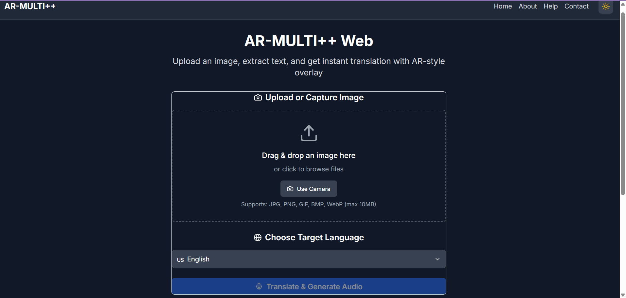
AR-MULTI++ in Action Interface :

Slide 19
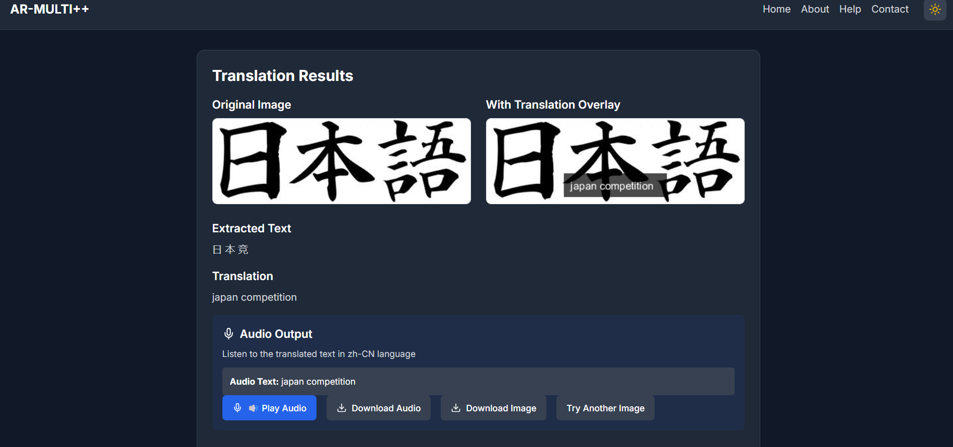
Output:

Slide 20
Conclusion
Integrates OCR, translation, TTS, and AR overlay in one platform.
Provides accurate multilingual text recognition.
Delivers fast and smooth end-to-end processing.
Offers a clean, responsive, and user-friendly UI.
Enhances real-world text understanding across languages.

Slide 21
References
Visual Features for Context –Aware speech Recognization-Pittsburgh, PA; U.S.A.(2016)
AugmentedRealityforSceneTextRecognition,Visualizationand ReadingtoAssistVisuallyImpairedPeople-Procedia Computer Science 207 (2022)
Applying augmented reality multimedia technology to construct a platform for translation and teaching system(2024) -School of Chinese Language and Literature, Liaoning Normal University, Dalian, 116021, China .
Huang, X.; Zou, D.; Cheng, G.; Xie, H. A Systematic Review of ARandVREnhancedLanguage Learning. Sustainability 2021, 13, 4639. https://doi.org/10.3390/su13094639 (2021)

Slide 22
Thank you

